Slide 1
Red Hat High Availability Clustering Overview & Setup
Indrajit Prasad, Satishkumar Bhopale, Dhirendra Pandey
02nd June 2026

Slide 2
What is Pacemaker Cluster?
A cluster is a set of computers working together on a single task. The task is performed, and how that task is performed, differs from cluster to cluster. Pacemaker is a high-availability cluster resource manager – software that runs on a set of hosts (a cluster of nodes) to preserve integrity and minimize downtime of desired services (resources). A cluster comprises two or more servers (called nodes or members) that work together to perform a task(s).
There are four major types of clusters:
Storage
High availability
Load balancing
High performance

Slide 3
Pacemaker HA Cluster Architecture Key Components
Pacemaker
Cluster Information Base (CIB)
Cluster Resource Management Daemon (CRMd) / PCSd
Shoot the Other Node in the Head (STONITH)
PCS
Corosync
Quorum ( Recommended for more then two node cluster)

Slide 4
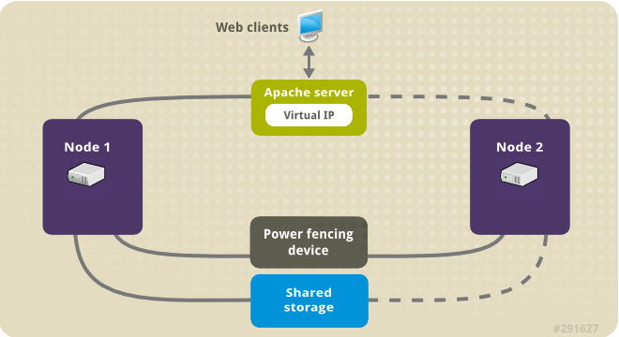
Why Do we need Cluster?
We need a Pacemaker Cluster for high availability, which involves using redundant servers to ensure continuous service and automatic failover in case of a failure.
Pacemaker detects failures, shuts down the affected service on the failed node, and moves it to another node to minimize downtime.
It also provides better performance by distributing workloads and ensures data integrity through redundancy.

Slide 5
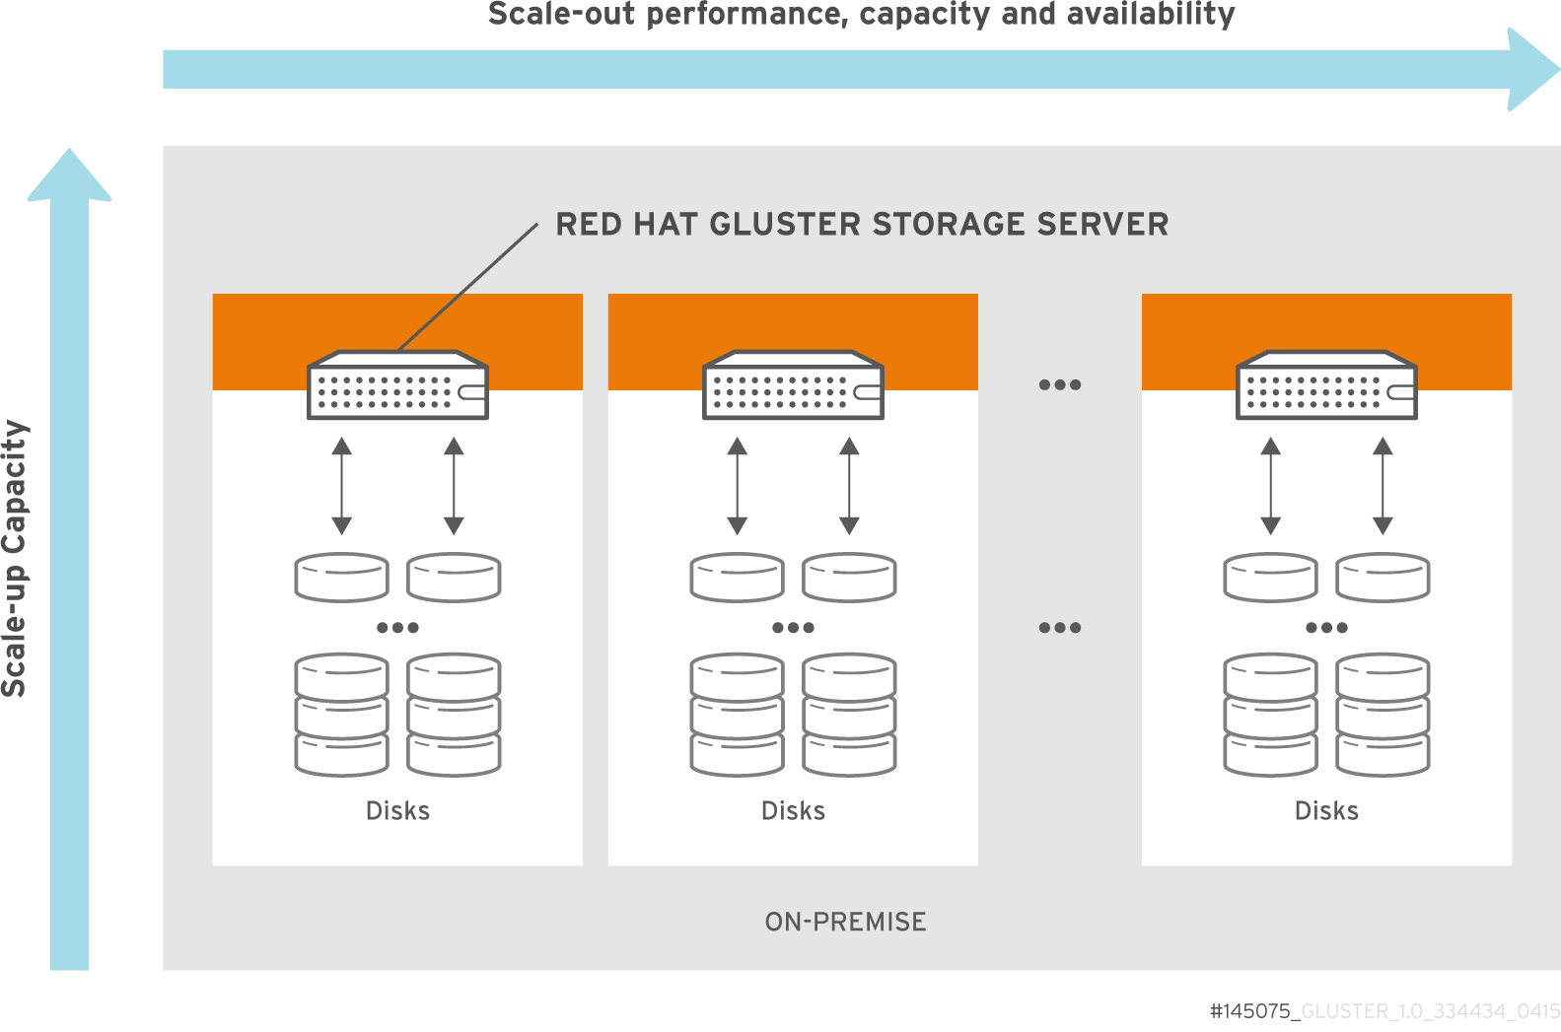
Major types of Clusters
Storage Cluster:
Storage clusters provide a consistent file system image across servers in a cluster, allowing the servers to simultaneously read and write to a single shared file system
A storage cluster simplifies storage administration by limiting the installation and patching of applications to one file system
Also, with a cluster-wide file system, a storage cluster eliminates the need for redundant copies of application data and simplifies backup and disaster recovery
The High Availability Add-On provides storage clustering in conjunction with Red Hat GFS2 (part of the Resilient Storage Add-On).

Slide 6
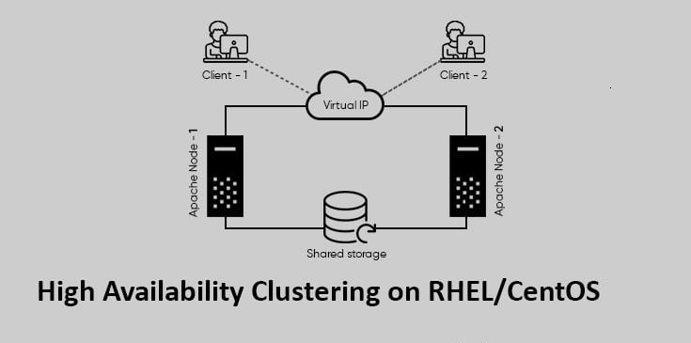
Major types of Clusters
High Availability Cluster:
Clusters provide highly available services by eliminating single points of failure and by failing over services from one cluster node to another in a node becomes inoperative.
Typically, services in a high availability cluster read and write data -. (by means of read-write mounted file systems). Therefore, a high availability cluster must maintain data integrity as one cluster node takes over control of a service from another cluster node
Node failures in a high availability cluster are not visible from clients outside the cluster. (High availability clusters are sometimes referred to as failover clusters)
The High Availability Add-On provides high availability clustering through its High Availability Service Management component

Slide 7
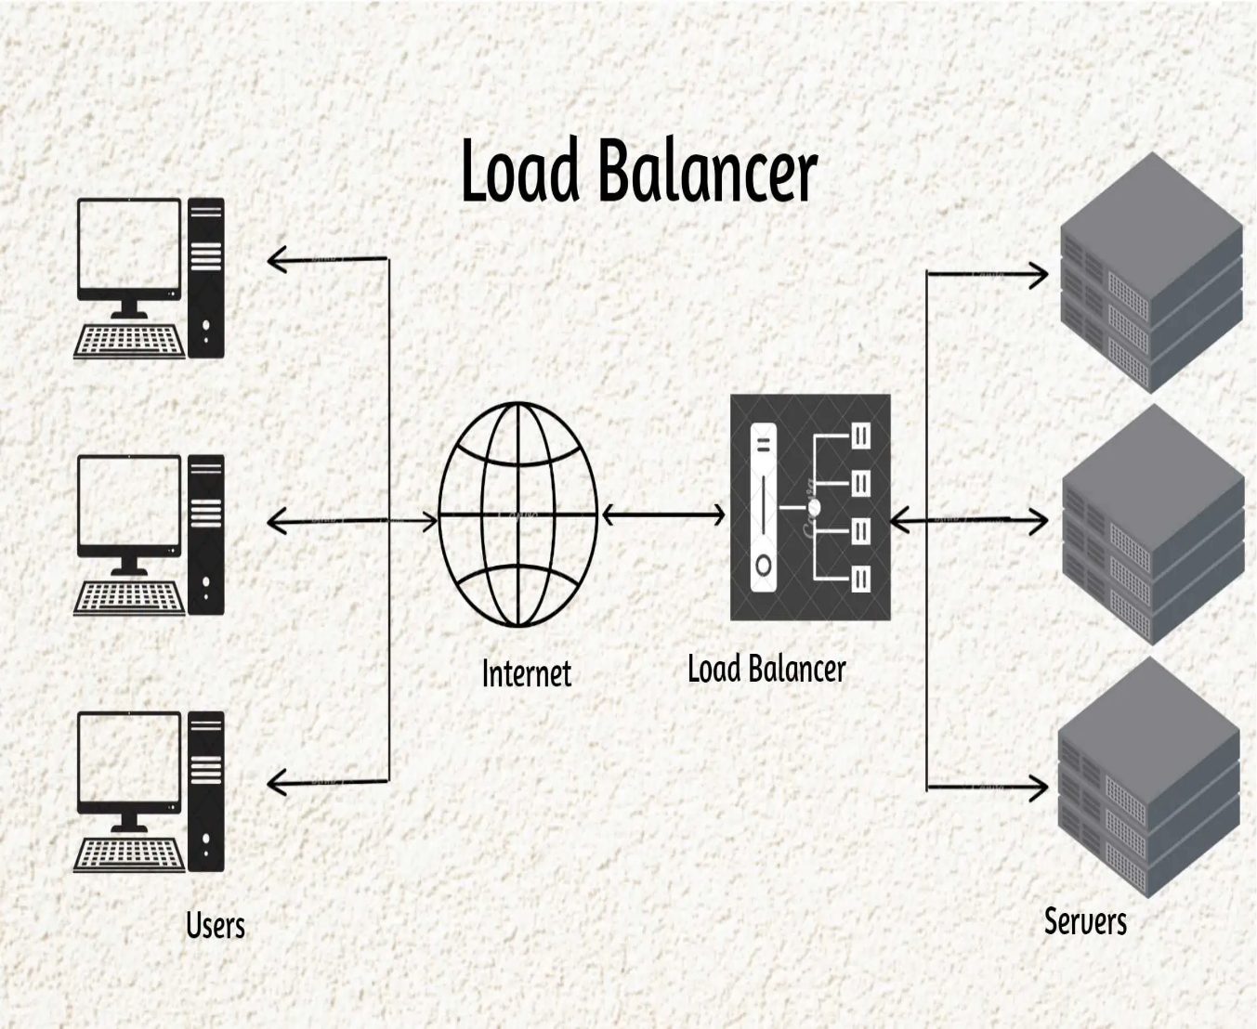
Major types of Clusters
Load Balancing Cluster:
Clusters dispatch network service requests to multiple cluster nodes to balance the request load among the cluster nodes
Load balancing provides cost-effective scalability because you can match the number of nodes according to load requirements. If a node in a load-balancing cluster becomes inoperative, the load-balancing software detects the failure and redirects requests to other cluster nodes
Node failures in a load-balancing cluster are not visible from clients outside the cluster. Load balancing is available with the Load Balancer Addon

Slide 8
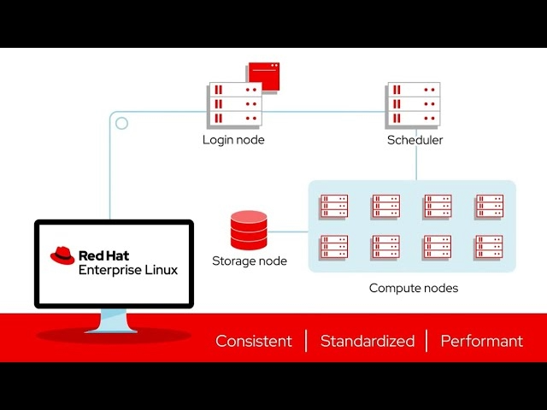
Major types of Clusters
High Performance Cluster:
Clusters use cluster nodes to perform concurrent calculations.
A high-performance cluster allows applications to work in parallel therefore, enhancing the performance of the applications
High performance clusters are also referred to as computational clusters or grid computing.
High-Performance Computing cluster is a networked group of powerful computers, called nodes, designed to work together to solve complex computational problems, simulation tasks, or data intensive workloads far faster than a single computer

Slide 9
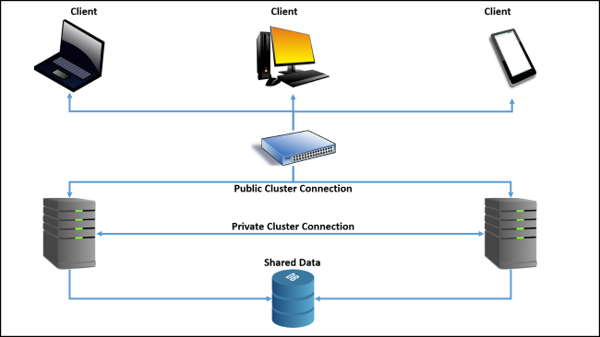
Key reasons for using Pacemaker Clustering
The primary purpose is to keep services running even if one server fails. When a primary server fails, Pacemaker automatically starts the services on a secondary server, often using a virtual IP address to redirect applications.

Slide 10
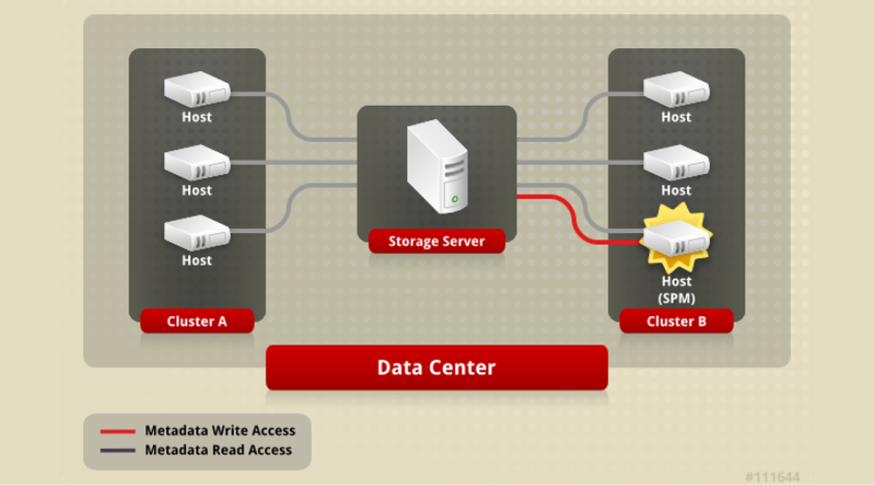
Key reasons for using Pacemaker clustering.
Fault Tolerance: It allows for automatic recovery from failures at both the node and resource levels.
Performance Improvement: Clusters can distribute workloads across multiple nodes to handle larger loads and process data more quickly than a single server.
Data Integrity: Redundant systems built into a cluster help protect against data loss or corruption.
Cost-Effectiveness: It can be used to create efficient configurations, such as using a single backup node to take over for multiple other nodes (N+1 redundancy).
Management and Automation: Pacemaker provides the "brain" to manage cluster behavior and has tools like the pcs command-line interface to help configure and monitor the cluster across all nodes.
Support for Various Configurations: It can handle various redundancy setups, including Active/Passive and Active/Active, and can run multiple copies of services to balance the workload.
Policy Engine (PEngine) : To make cluster decisions in background with the help of Quorum/Fencing.

Slide 11
Pacemaker HA Cluster Architecture Key Functions Components
A cluster configured with Pacemaker comprises separate component daemons that monitor cluster membership, scripts that manage the services, and resource management subsystems that monitor the disparate resources. The following components form the Pacemaker architecture:
Packages Required : pcs , pacemaker , fence-agents-all
PCSD is a crucial Daemon service that enables the management and configuration of Pacemaker and Corosync clusters.
Key Functions of PCSd :
Remote Configuration Interface: pcsd runs as a daemon on each node in the cluster and acts as a remote server for the pcs command-line interface tool. This allows an administrator to run pcs commands on one node and have those configuration changes synchronized across all other nodes in the cluster via pcsd.
Web UI Backend: It provides the backend service for the pcsd Web UI, a graphical user interface used to create, configure, and monitor the cluster.
Authentication and Synchronization: It handles authentication between cluster nodes (using the hacluster user by default) and ensures that configuration files and SSL certificates are synchronized across the entire cluster.

Slide 12
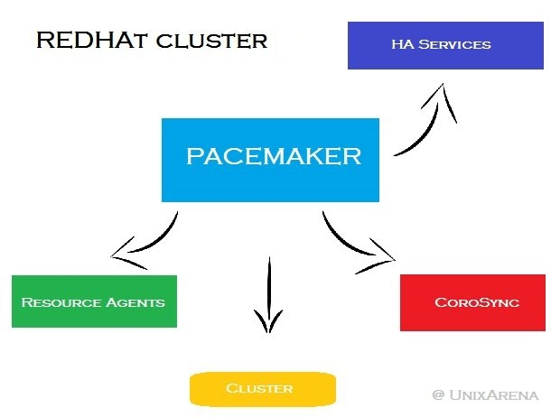
Ports used of a Pacemaker High Availability Cluster
TCP Port : 2224/TCP
UDP Ports : 5404-5412/UDP

Slide 13
Software Configuration of a Pacemaker HA Cluster
Pacemaker
This is the component responsible for all cluster-related activities, such as monitoring cluster membership, managing the services and resources and fencing cluster members. The pacemaker RPM package contains three important facilities:
Cluster Information Base (CIB): The CIB contains configuration and status information about the cluster and the cluster resources in XML format. A cluster node in the cluster gets elected by Pacemaker to act as a designated coordinator (DC), and stores cluster and resource status and cluster configuration that gets synchronized to all other active cluster nodes. The scheduler (pacemaker-schedulerd) uses the contents of the CIB to compute the ideal state of the cluster and how to reach it.
Conf File : /var/lib/pacemaker/cib/cib.xml
Cluster Resource Management Daemon (CRMd): The Cluster Resource Management Daemon coordinates and sends the resource start, stop, and status query actions to the Local Resource Management Daemon (LRMd) that runs on every cluster node. The LRMd passes the actions received from the CRMd to the resource agents.
Conf File : /etc/pacemaker/cluster.conf
Shoot the Other Node in the Head (STONITH): STONITH is the facility responsible for processing fence requests and forwards the requested action to the fence devices configured in the CIB.
Fencing :-
Fencing is a mechanism that ensures a malfunctioning cluster node cannot cause corruption on the cluster, because the node could still have access to the cluster resources. Fencing also allows the cluster to safely recover its resources on another node. This is necessary because you cannot assume that an unreachable node is actually off. Fencing is often accomplished by powering the node off, because a dead node is clearly not able to do anything. In other cases, a combination of operations is used to cut the node off from the network (to stop the cluster allocating resources on that node) or from storage (to stop the node from writing to shared storage).

Slide 14
Software Configuration of a Pacemaker HA Cluster
pcs
The pcs RPM package contains two cluster configuration tools:
The pcs command provides a command-line interface to create, configure, and control every aspect of a
Pacemaker/Corosync cluster.
pcsd (Web UI)
The pcsd service provides the cluster configuration synchronization and a web front end to create and configure a Pacemaker/Corosync cluster.
corosync
This is the framework used by Pacemaker for handling communication between the cluster nodes. corosync is also Pacemaker's source of membership.
Conf File : /etc/corosync/corosync.conf
Cluster Logs File : /var/log/pacemaker/pacemaker.log or /var/log/pcsd/pcsd.log /var/log/messages: A general system log file that may contain related cluster events and errors.

Slide 15
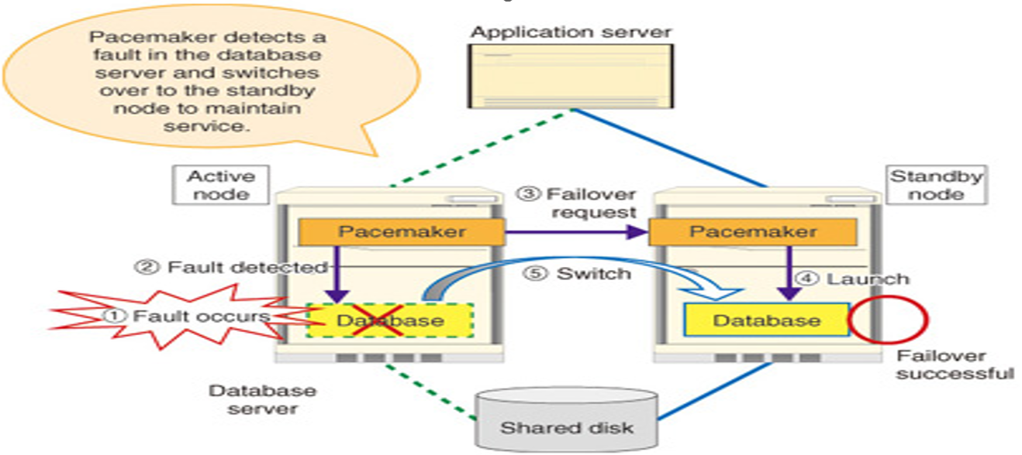
Red Hat Pacemaker HA Cluster 2 Node Setup

Slide 16
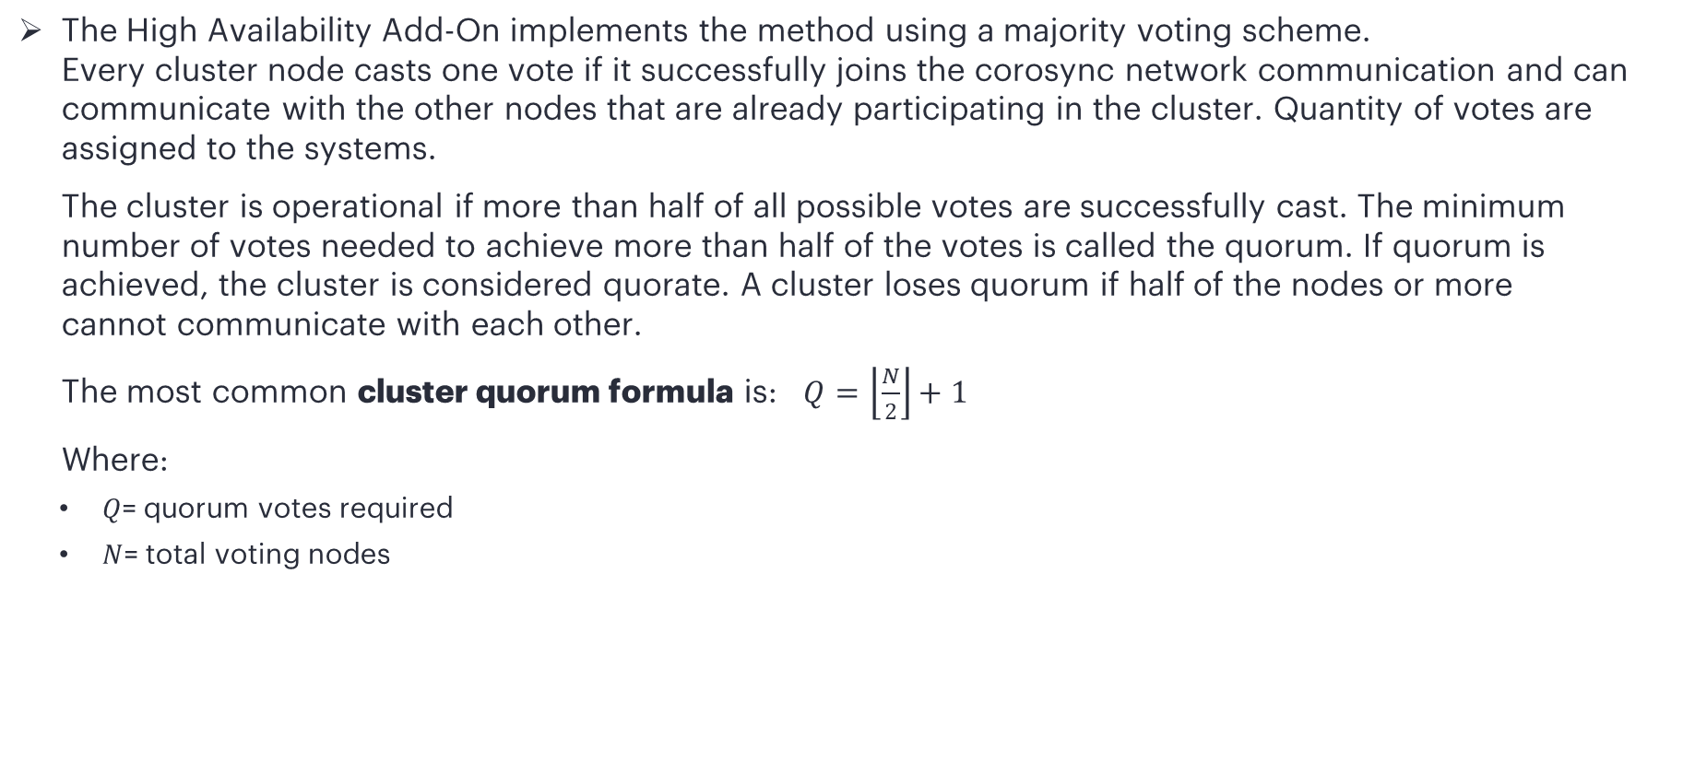
What is Quorum?
The High Availability Add-On implements the method using a majority voting scheme. Every cluster node casts one vote if it successfully joins the corosync network communication and can communicate with the other nodes that are already participating in the cluster. Quantity of votes are assigned to the systems.
The cluster is operational if more than half of all possible votes are successfully cast. The minimum number of votes needed to achieve more than half of the votes is called the quorum. If quorum is achieved, the cluster is considered quorate. A cluster loses quorum if half of the nodes or more cannot communicate with each other.
The most common cluster quorum formula is: $Q=\left\lfloor \frac{N}{2}\right\rfloor +1$
Where:
$Q$= quorum votes required
$N$= total voting nodes

Slide 17
Configuring quorum options
There are some special features of quorum configuration that you can set when you create a cluster with the pcs cluster setup command.
auto_tie_breaker - The cluster partition, or the set of nodes that are still in contact with the nodeid configured in auto_tie_breaker_node (or lowest nodeid if not set), will remain quorate. The other nodes will be inquorate. The auto_tie_breaker option is principally used for clusters with an even number of nodes, as it allows the cluster to continue operation with an even split. The auto_tie_breaker option is incompatible with quorum devices.
wait_for_all - The wait_for_all option is automatically enabled when a cluster has two nodes, does not use a quorum device, and auto_tie_breaker is disabled. cluster members to be online before starting to calculate quorum.
last_man_standing - When enabled, the cluster can dynamically recalculate expected votes and quorum under specific circumstances. You must enable wait_for_all when you enable this option.

Slide 18
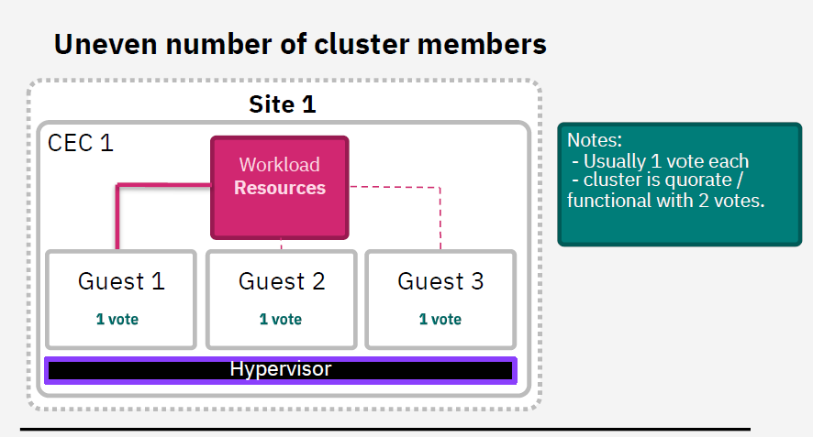
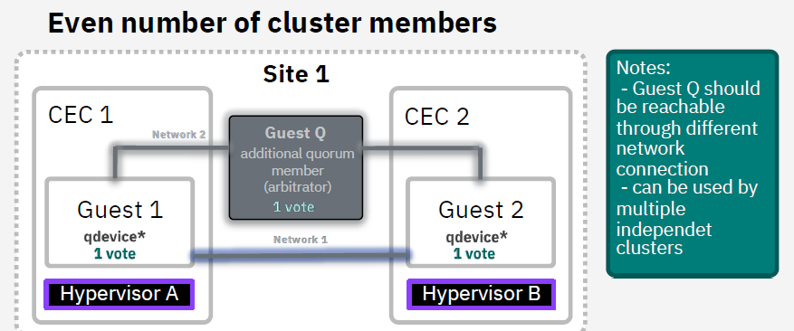
Red Hat Pacemaker HA Cluster Node Setup
Corosync Vote quorum
Quorum decides how many guests can fail before the cluster becomes non-operational.
Quantity of votes are assigned to the systems.
Only when a majority of votes are present the cluster operations are allowed to proceed.
With 1 CEC an uneven amount of nodes ensures quorum when 1 node fails.
With 2 CECs you either need: a) A third cluster member on a neutral/third side. b) Or a quorum server on a neutral/third side which only votes but does not participate otherwise.
(See next slides for reasons on why a third side is needed)

Slide 19
Quorum – 2/3-Nodes Challenges

Slide 20
Introducing High Availability Cluster Configurations
High availability cluster configurations can be grouped into two subsets.
1. Active-Active - high availability clusters, where a service runs on multiple nodes, thus leading to shorter failover times. The main goal of these type of clusters is to perform Load balancing, and thus, they can scale to many instances handling higher loads. However, they require load balancer devices to perform this load balancing. Active -Active HA clusters can be as small as only two nodes. If one node fails, then the cluster redirects all the workload to the rest of the nodes. When the failing node recovers, then the cluster distributes again the workload between the available nodes.

Slide 21
Introducing High Availability Cluster Configurations
2. Active-Passive - high availability clusters, where a service only runs on one node at a time. When one node fails, then the only then the cluster starts the service on another one to replace it. This configuration requires Fencing to restrict the access of an unresponsive node to the cluster resources, avoiding corruption on the cluster. Fencing is covered more in detail later in this course.

Slide 22







The primary Linux distributions that officially support and include Pacemaker as part of their High Availability (HA) add-ons are:
To configure a PCS (Pacemaker/Coro sync) HA cluster on Linux, several prerequisites must be met across all intended nodes. These requirements ensure reliable communication, data integrity, and high availability (HA) operation.

Slide 23
Pacemaker HA Cluster General System & Networking
Identical Operating System All nodes in the cluster should run the same Linux distribution and version (e.g., Red Hat Enterprise Linux 8.x or SUSE Linux Enterprise Server 15.x) with the same architecture.
IP Addresses all cluster nodes must use static IP addresses. Dynamic IP configurations are not suitable for a stable cluster environment.
Time Synchronization all nodes must be synchronized to the same date and time, ideally using a Network Time Protocol (NTP) server outside the cluster. Time drift can cause significant operational problems.

Slide 24
Pacemaker HA Cluster General System & Networking
Network Connectivity there should be redundant network communication paths between nodes to ensure the cluster can operate if one path fails. Network bonding is a recommended method.
Firewall Configuration If firewalls are active (e.g., firewalld), they must be configured to allow cluster communication on required ports / Service (e.g., TCP ports 2224, 3121, 21064 and UDP port 5405 / high – availability for Pacemaker/Coro sync).
Enable Cluster LVM (CLVM): Install the necessary packages for CLVM (e.g., lvm2-cluster on RHEL/CentOS. Configure lvmlockd and clvmd as Pacemaker resources.
Create a DLM (Distributed Lock Manager) resource, which lvmlockd depends on.

Slide 25
HA Cluster Software & password less Access between Node/Members
Required Packages the pcs, pacemaker, corosync, resource-agents, and appropriate fence-agent packages must be installed on all nodes.
hacluster User The installation process creates a system user named hacluster. A password for this user must be set on all nodes, and it should be the same on each to simplify configuration.
Passwordless SSH (Optional but Recommended) For simplified management and troubleshooting tools (like Log report or History Explorer), passwordless SSH access for the root user ( potentially other application users) between all cluster nodes is highly recommended.

Slide 26
HA Cluster Mechanisms
Fencing (STONITH) A fencing mechanism is mandatory for a supported production cluster to prevent "split-brain" scenarios and ensure data integrity. This typically involves:
STONITH ("Shoot the other node in the head") devices, such as a managed power switch, a storage-based device (SBD), or a cloud-specific agent (e.g., for AWS or Azure).
The global cluster option stonith-enabled must be set to true.
Quorum For clusters with more than two nodes, using an odd number of nodes is strongly recommended to easily achieve a quorum (a majority decision on cluster status). For two-node clusters, a Q Device (Quorum Device) on a separate third host or SBD (STONITH by disk) is typically used for robust quorum determination.

Slide 27
HA Cluster Mechanisms
Shared Storage Depending on the application, shared storage (e.g., a Storage Area Network (SAN) or NFS share) must be configured and accessible from all cluster nodes, though only one node should be active at any given time for most active/passive setups.
Virtual IP Address A virtual IP (VIP) address is required for clients to access the highly available service independently of which physical node it is running on.

Slide 28
Thank you

